Slide 1
THE SCIENCE OF SIN AND SALVATION
ROBERT MELASHENKO MD
Copyright Robert Melashenko 2013
All Rights Reserved

Slide 2
LECTURE THIRTEEN
THE END OF SIN AND SINNERS

Slide 3
REVIEW
Grace is the part that God plays in editing and rewriting our code to eliminate any traces of the Devil’s handiwork, and in so doing making us impervious to the Devil’s advances (temptations).
Faith is the part that we must play to allow God full access to our information system so that He can institute Grace on our behalf.
Sanctification is the final result of Grace and Faith working together in an individual to remove any of the Devil’s code and replace the original information which had been lost.
Justification says that we are “fit” for heaven, because we have been sanctified. God is “just” in welcoming us into His heavenly courts because our genome is perfectly compatible with life there—therefore we belong there!

Slide 4
God provides the “know-how”, the power, guarantees not to overwhelm us, directs the Holy Spirit in the process, is able to correct any genome (no matter how degraded), and will finish the job of sanctification if we will only put our faith (cooperation) in Him.
However, cooperating with the sanctification process requires that we “remain under” even when temptations and trials specially suited to aid in God’s rewriting process befall us.
Then said Jesus to his disciples, If any man will come after me, let him deny himself, and take up his cross, and follow me.
(Matthew 16:24 AKJV)

Slide 5
ARE WE EXPECTED TO DO SOMETHING IN OUR SALVATION?
Remain under
Keep the Sabbath
Tell others

Slide 6
Why is the Sabbath a special day ?
To you first God, having raised up his Son Jesus, sent him to bless you, in turning away every one of you from his iniquities.
(Acts 3:26 AKJV)
And God blessed the seventh day, and sanctified it: because that in it he had rested from all his work which God created and made. (Gen 2:3 KJV)
Moreover also I gave them my Sabbaths, to be a sign between me and them, that they might know that I am the LORD that sanctify them. (Ezekiel 20:12 AKJV)

Slide 7
If you turn away your foot from the Sabbath, from doing your pleasure on my holy day; and call the Sabbath a delight, the holy of the LORD, honorable; and shall honor him, not doing your own ways, nor finding your own pleasure, nor speaking your own words: Then shall you delight yourself in the LORD; and I will cause you to ride on the high places of the earth, and feed you with the heritage (possession, property, inheritance, heritage) of Jacob your father: for the mouth of the LORD has spoken it.
(Isaiah 58:13-14 AKJV)

Slide 8
For dieters, bandwidth scarcity has one particularly important consequence, illustrated in one study that gave people a choice between fruit salad and cake. Before choosing, half of the subjects had their bandwidth taxed: they were asked to remember a seven-digit number. The other half had a mentally less-demanding task: they were asked to remember a two-digit number. Those with less available bandwidth ate more cake: they were 50 percent more likely to choose cake than the others. There is a paradox here: diets create mental conditions that make it hard to diet.
New York Times September 21, 2013

Slide 9
So then faith comes by hearing, and hearing by the word of God. (Romans 10:17 AKJV)
Husbands, love your wives, even as Christ also loved the church, and gave himself for it; That he might sanctify and cleanse it with the washing of water by the word, (Ephesians 5:25-26 AKJV)
Being born again, not of corruptible seed, but of incorruptible, by the word of God, which lives and stays for ever. (1 Peter 1:23 AKJV)

Slide 10
Tell Others
Go you therefore, and teach all nations, baptizing them in the name of the Father, and of the Son, and of the Holy Ghost: Teaching them to observe all things whatever I have commanded you: and, see, I am with you always, even to the end of the world. Amen.
(Matthew 28:19-20 AKJV)

Slide 11
Only the Creator of the information system can repair and rewrite the code.
In the beginning was the Word, and the Word was with God, and the Word was God. The same was in the beginning with God. All things were made by him; and without him was not any thing made that was made.
(John 1:1-3 AKJV)
Neither is there salvation in any other: for there is none other name under heaven given among men, whereby we must be saved.
(Acts 4:12 AKJV)

Slide 12
When does this “sanctification” occur—now, or in the future?
Teaching us that, denying ungodliness and worldly lusts, we should live soberly, righteously, and godly, in this present world; (Titus 2:12 AKJV)
That you may be blameless and harmless, the sons of God, without rebuke, in the middle of a crooked and perverse nation, among whom you shine as lights in the world;
(Philippians 2:15 AKJV)
Having a form of godliness, but denying the power thereof: from such turn away.
(2 Timothy 3:5 AKJV)

Slide 13
WHAT HAPPENS WHEN CHRIST REMAKES US?
Whoever is born of God does not commit sin; for his seed remains in him: and he cannot sin, because he is born of God.
(1 John 3:9 AKJV)
Therefore if any man be in Christ, he is a new creature: old things are passed away; behold, all things are become new.
(2 Corinthians 5:17 AKJV)
This does not mean that we will never make a mistake--because we still have defective hardware and software. What it does mean is that we will no longer listen (much less give thought to) the Evil One when he comes to seduce us. This will be the case for the 144,000 spoken of in Revelation 14.

Slide 14
We will become “one”.
My little children, of whom I travail in birth again until Christ be formed in you,
(Galatians 4:19 AKJV)
By this shall all men know that you are my disciples, if you have love one to another.
(John 13:35 AKJV)
That they all may be one; as you, Father, are in me, and I in you, that they also may be one in us: that the world may believe that you have sent me.
(John 17:21 AKJV)

Slide 15
With rewritten code, Christ’s followers will think and behave like their Author—that is why they will naturally congregate together and form His church.

Slide 16
WHAT HAPPENS TO THE PEOPLE WHO TURN GOD DOWN ON HIS GRACIOUS OFFER?
DOES GOD ETERNALLY BURN THEM?
DO THEY DIE?
IF SO, DOES GOD KILL THEM?

Slide 17
George Carlin on Religion
“Religion has convinced people that there's an invisible man ... living in the sky. Who watches everything you do every minute of every day. And the invisible man has a list of ten specific things he doesn't want you to do. And if you do any of these things, he will send you to a special place, of burning and fire and smoke and torture and anguish for you to live forever, and suffer, and suffer, and burn, and scream, until the end of time. But he loves you. He loves you. He loves you and he needs money.”

Slide 18
FIRST WE NEED TO START WITH THE DEFINITION OF “JUDGMENT”.

Slide 19
Judgment
krisis
Thayer Definition:
1) a separating, sundering, separation
1a) a trial, contest
2) selection
3) judgment
3a) opinion or decision given concerning anything
3a1) especially concerning justice and injustice, right or wrong
3b) sentence of condemnation, damnatory judgment, condemnation and punishment
4) the college of judges (a tribunal of seven men in the several cities of Palestine; as distinguished from the Sanhedrin, which had its seat at Jerusalem)
5) right, justice

Slide 20
And as it is appointed to men once to die, but after this the judgment:
(Hebrews 9:27 AKJV)
For we must all appear before the judgment seat of Christ; that every one may receive the things done in his body, according to that he has done, whether it be good or bad.
(2 Corinthians 5:10 AKJV)

Slide 21
What does Christ say about how He will judge?
And if any man hear my words, and believe not, I judge him not: for I came not to judge the world, but to save the world. He that rejects me, and receives not my words, has one that judges him: the word that I have spoken, the same shall judge him in the last day.
(John 12:47-48 AKJV)

Slide 22
And he said, You can not see my face: for there shall no man see me, and live.
(Exodus 33:20 AKJV)
For our God is a consuming fire.
(Hebrews 12:29 AKJV)
and to give you who are troubled rest with us when the Lord Jesus is revealed from heaven with His mighty angels, in flaming fire taking vengeance on those who do not know God, and on those who do not obey the gospel of our Lord Jesus Christ. These shall be punished with everlasting destruction from the presence of the Lord and from the glory of His power,
(2Thess. 1:7-9)

Slide 23
God is a consuming Fire; What does this have to do with Judgment?
Every man's work shall be made manifest: for the day shall declare it, because it shall be revealed by fire; and the fire shall try every man's work of what sort it is. (1 Corinthians 3:13 AKJV)
And this is the condemnation, that light is come into the world, and men loved darkness rather than light, because their deeds were evil. For every one that does evil hates the light, neither comes to the light, lest his deeds should be reproved. But he that does truth comes to the light, that his deeds may be made manifest, that they are worked in God.
(John 3:19-21 AKJV)

Slide 24
What is this “light” that Christ refers to?
Who only has immortality, dwelling in the light which no man can approach to; whom no man has seen, nor can see: to whom be honor and power everlasting. Amen.
(1 Timothy 6:16 AKJV)

Slide 25
And the kings of the earth, and the great men, and the rich men, and the chief captains, and the mighty men, and every slave, and every free man, hid themselves in the dens and in the rocks of the mountains; And said to the mountains and rocks, Fall on us, and hide us from the face of him that sits on the throne, and from the wrath of the Lamb: For the great day of his wrath is come; and who shall be able to stand?
(Revelation 6:15-17 AKJV)
And it shall be said in that day, See, this is our God; we have waited for him, and he will save us: this is the LORD; we have waited for him, we will be glad and rejoice in his salvation.
(Isaiah 25:9 AKJV)

Slide 26
Why do the two groups react so differently at Christ’s Second Coming?
I counsel you to buy of me gold tried in the fire, that you may be rich; and white raiment, that you may be clothed, and that the shame of your nakedness do not appear; and anoint your eyes with eye salve, that you may see.
(Revelation 3:18 AKJV)
But who may abide the day of his coming? and who shall stand when he appears? for he is like a refiner's fire, and like fullers' soap: And he shall sit as a refiner and purifier of silver: and he shall purify the sons of Levi, and purge them as gold and silver, that they may offer to the LORD an offering in righteousness.
(Malachi 3:2-3 AKJV)

Slide 27
For, behold, the day comes, that shall burn as an oven; and all the proud, yes, and all that do wickedly, shall be stubble: and the day that comes shall burn them up, said the LORD of hosts, that it shall leave them neither root nor branch.
(Malachi 4:1 AKJV)

Slide 28
For the Son of man shall come in the glory of his Father with his angels; and then he shall reward every man according to his works.
(Matthew 16:27 AKJV)
Two groups of human beings. Why does God’s glory affect each group in such a contrary way?

Slide 29
MGE’s
And he said to him, Why call you me good? there is none good but one, that is, God: but if you will enter into life, keep the commandments.
(Matthew 19:17 AKJV)
And I will give to you the keys of the kingdom of heaven: and whatever you shall bind on earth shall be bound in heaven: and whatever you shall loose on earth shall be loosed in heaven.
(Matthew 16:19 AKJV)

Slide 30
Note, everyone referred to in this text fully ascribes to:
Loving God
Doing good works
Asking for forgiveness
Not every one that said to me, Lord, Lord, shall enter into the kingdom of heaven; but he that does the will of my Father which is in heaven.
Many will say to me in that day, Lord, Lord, have we not prophesied in your name? and in your name have cast out devils? and in your name done many wonderful works?
And then will I profess to them, I never knew you: depart from me, you that work iniquity.
(Matthew 7:21-23 AKJV)

Slide 31
What could Christ mean when He says, “I never knew you”?
And hereby we do know that we know him, if we keep his commandments. He that said, I know him, and keeps not his commandments, is a liar, and the truth is not in him.
(1 John 2:3-4 AKJV)
And he said to him, Why call you me good? there is none good but one, that is, God: but if you will enter into life, keep the commandments.
(Matthew 19:17 AKJV)

Slide 32
How do we “keep His commandments”?
Whoever is born of God does not commit sin; for his seed remains in him: and he cannot sin, because he is born of God.
(1 John 3:9 AKJV)

Slide 33
What happens to those who do not “keep His commandments”?
You are of your father the devil, and the lusts of your father you will do. He was a murderer from the beginning, and stayed not in the truth, because there is no truth in him. When he speaks a lie, he speaks of his own: for he is a liar, and the father of it.
(John 8:44 AKJV)
And then they will come to their senses and escape from the trap of the Devil, who had caught them and made them obey his will.
(2 Timothy 2:26 GNB)

Slide 34
MGE’s epitomize information bits in an information universe. We have come full circle - Again it is Information!

Slide 35
WHAT WILL HAPPEN TO THE MGE’s?
Surely wickedness burns like a fire; it consumes briers and thorns, it sets the forest thickets ablaze, so that it rolls upward in a column of smoke.
By the wrath of the LORD Almighty the land will be scorched and the people will be fuel for the fire; no one will spare his brother.
(Isaiah 9:18-19 NIV)
Terror will seize them, pain and anguish will grip them; they will writhe like a woman in labor. They will look aghast at each other, their faces aflame.
(Isaiah 13:8 NIV)

Slide 36
Why do the people burn who do not “know” God?
Answer: Information Theory

Slide 37
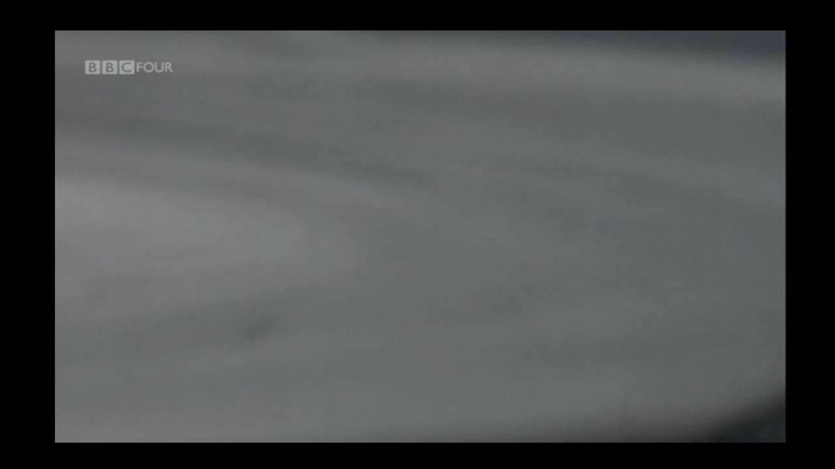
BBC: Order & Disorder

Slide 38
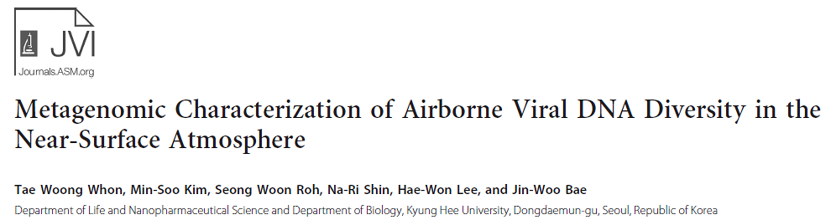
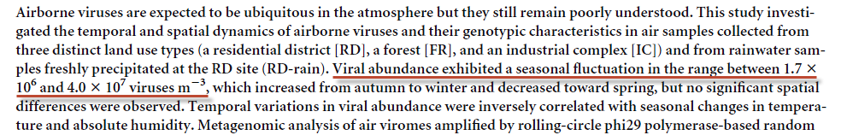
(1,700,000 – 40,000,000)
Journal of Virology August 2012 Volume 86 Number 15

Slide 39
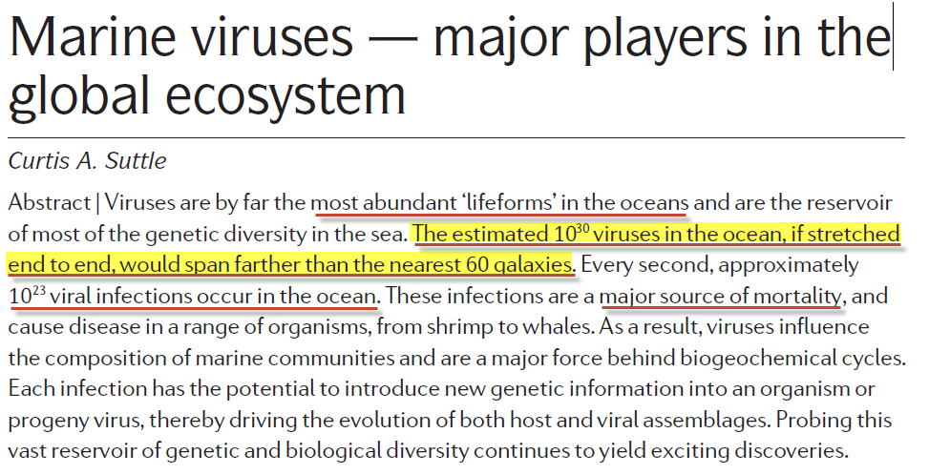
NATURE REVIEWS | MICROBIOLOGY VOLUME 5 | OCTOBER 2007

Slide 40
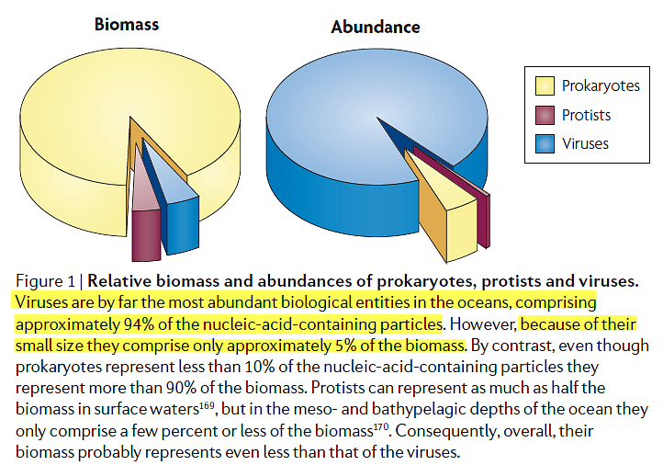
NATURE REVIEWS | MICROBIOLOGY VOLUME 5 | OCTOBER 2007

Slide 41
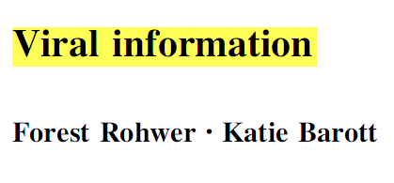
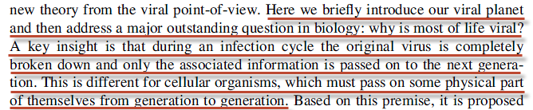
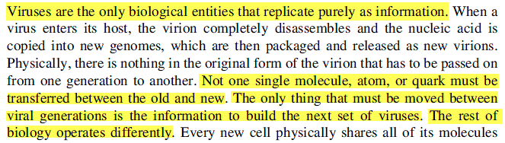
Biol Philos (2013) 28:283–297

Slide 42
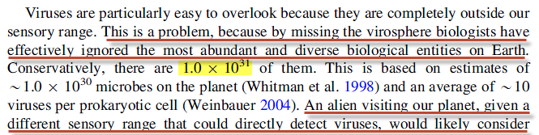
Welcome to the viral world
Biol Philos (2013) 28:283–297

Slide 43
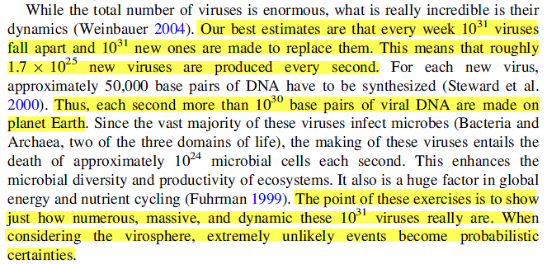
Biol Philos (2013) 28:283–297

Slide 44
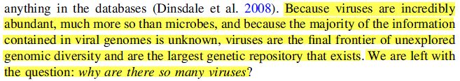
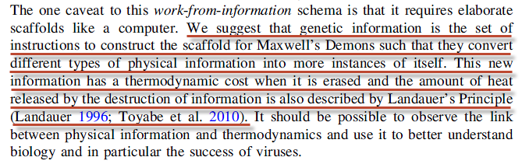
Demons and information
Biol Philos (2013) 28:283–297

Slide 45
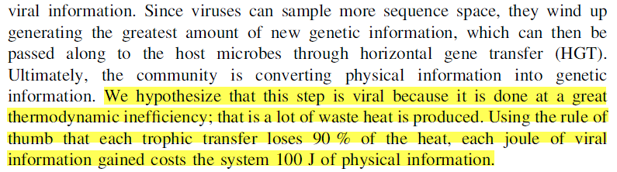
Viral information and the rest of biology
Biol Philos (2013) 28:283–297

Slide 46
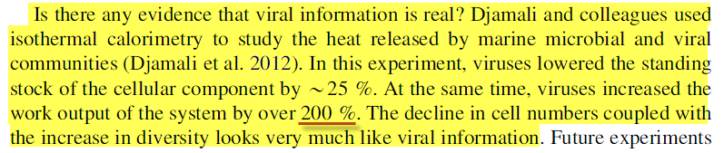
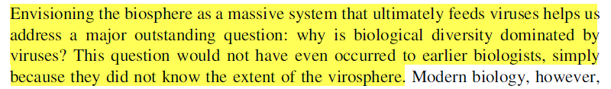
Measuring viral information
Conclusion

Slide 47
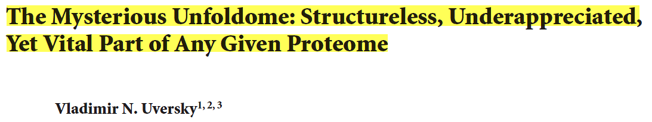
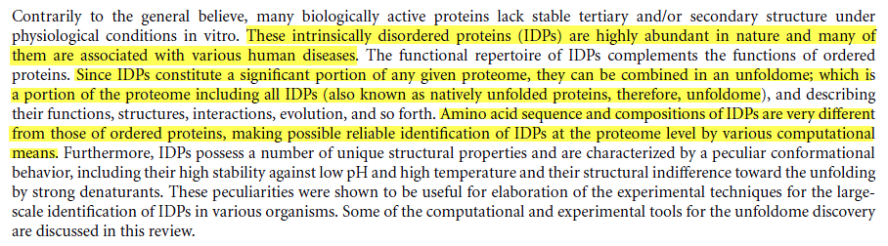

Journal of Biomedicine and Biotechnology. Volume 2010, Article ID 568068

Slide 48
I, even I, am he that blots out your transgressions for my own sake, and will not remember your sins. (Isaiah 43:25 AKJV)
For the LORD shall rise up as in mount Perazim, he shall be wroth as in the valley of Gibeon, that he may do his work, his strange work; and bring to pass his act, his strange act.
(Isaiah 28:21 AKJV)

Slide 49
The sinners in Zion are afraid; fearfulness has surprised the hypocrites. Who among us shall dwell with the devouring fire? who among us shall dwell with everlasting burnings?
(Isaiah 33:14 AKJV)
Behold, they shall be as stubble; the fire shall burn them; they shall not deliver themselves from the power of the flame: there shall not be a coal to warm at, nor fire to sit before it.
(Isaiah 47:14 AKJV)

Slide 50
And they went up on the breadth of the earth, and compassed the camp of the saints about, and the beloved city: and fire came down from God out of heaven, and devoured them.
(Revelation 20:9 AKJV)
And death and hell were cast into the lake of fire. This is the second death.
And whoever was not found written in the book of life was cast into the lake of fire.
(Revelation 20:14-15 AKJV)

Slide 51
Seeing then that all these things shall be dissolved, what manner of persons ought you to be in all holy conversation and godliness,
Looking for and hastening to the coming of the day of God, wherein the heavens being on fire shall be dissolved, and the elements shall melt with fervent heat?
(2 Peter 3:11-12 AKJV)

Slide 52
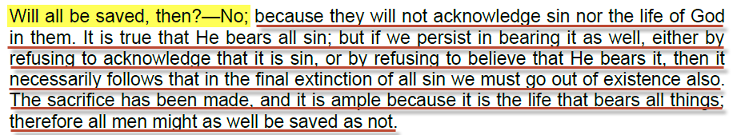
For whoever shall keep the whole law, and yet offend in one point, he is guilty of all.
(James 2:10 AKJV)
Ellet J. Waggoner, 24 Lessons from Hebrews. P13

Slide 53
When He comes the second time why doesn’t Christ’s glory cause the “second death” in the wicked who witness it?
Therefore judge nothing before the appointed time; wait till the Lord comes. He will bring to light what is hidden in darkness and will expose the motives of men's hearts. At that time each will receive his praise from God.
(1 Corinthians 4:5 NIV)

Slide 54
If God’s glory will define who is “lost” and who is “saved”, why does Daniel talk of a judgment where the books are open?
I beheld till the thrones were cast down, and the Ancient of days did sit, whose garment was white as snow, and the hair of his head like the pure wool: his throne was like the fiery flame, and his wheels as burning fire.
A fiery stream issued and came forth from before him: thousand thousands ministered to him, and ten thousand times ten thousand stood before him: the judgment was set, and the books were opened.
(Daniel 7:9-10 AKJV)

Slide 55

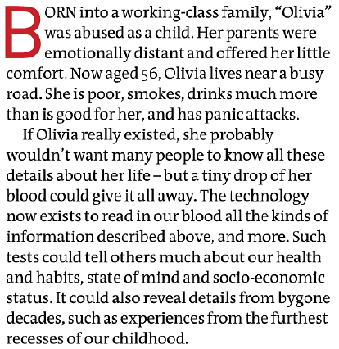
New Scientist. November 16, 2013. p47

Slide 56

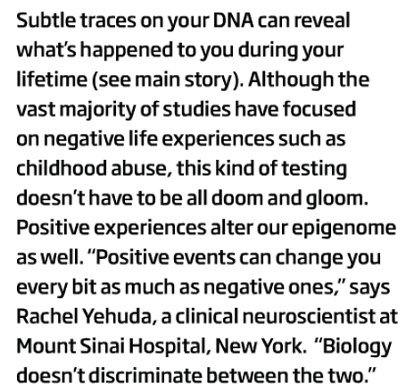
New Scientist. November 16, 2013. p49

Slide 57
What need could there be for an “Investigative Judgment” if God’s glory will divide the “sheep” from the “goats”, and if He knows the number of the hairs on our heads (Matt 10:30)?
To him that overcomes will I grant to sit with me in my throne, even as I also overcame, and am set down with my Father in his throne. (Revelation 3:21 AKJV)
Jesus Christ the same yesterday, and to day, and for ever. (Hebrews 13:8 AKJV)

Slide 58
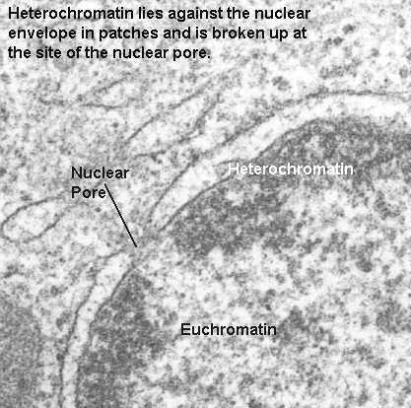
Heterochromatin

Slide 59
But he that does wrong shall receive for the wrong which he has done: and there is no respect of persons.
(Colossians 3:25 AKJV)
Why God also has highly exalted him, and given him a name which is above every name:
That at the name of Jesus every knee should bow, of things in heaven, and things in earth, and things under the earth;
And that every tongue should confess that Jesus Christ is Lord, to the glory of God the Father.
(Philippians 2:9-11 AKJV)

Slide 60
Grand Unifying Theory

